Slide 1
“Electrons in Atoms”
Day 1

Slide 2
Niels Bohr’s Model
Move like planets around the sun.
  In specific circular paths, or orbits, at different levels.
  An amount of fixed energy separates one level from another.

Slide 3
Energy levels
Electrons exists in different energy levels…think of rungs on a ladder.
The ground under the ladder is the nucleus
  more energy = farther away from the nucleus!
  Ground state = lowest rung on the ladder
When an electron moves up the rungs of the ladder, we call it a “quantum leap”
Absorbs energy when moving to a higher energy level
Releases energy (called photons) in the form of light
http://www.colorado.edu/physics/2000/quantumzone/bohr.html

Slide 4
The Quantum Mechanical Model
The atom is found inside a blurry “electron cloud”
An area where there is a chance of finding an electron.
90% chance of finding an electron here

Slide 5
Atomic Orbitals
Principal Quantum Number (n) = the energy level of the e⁻: 1, 2, 3, etc.
Sublevels - s, p, d, and f
atomic orbitals - regions where there is a high probability of finding an electron.
http://www.colorado.edu/physics/2000/applets/a2.html

Slide 6
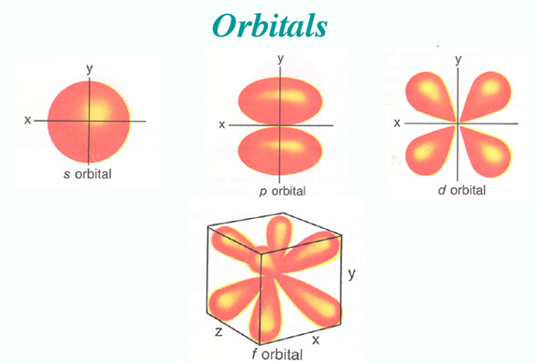

Slide 7
To show how various electrons had certain energies, scientists developed an Energy Diagram.

Slide 8
Energy Diagrams
7p
6d
7s
5f
6p
5d
6s
4f
5p
4d
5s
4p
4s
3d
3p
Increasing energy
3s
2p
2s
1s

Slide 9
Energy Diagrams
Aufbau principle – German for “build up” electrons enter the lowest energy first.
Pauli Exclusion Principle - at most 2 e- per orbital - different spins
Hund’s Rule- When e- occupy orbitals of = energy, they don’t pair up until they have to.
Let’s look at the energy diagram P
  We need to account for all 15 electrons in phosphorus

Slide 10
7p
6d
7s
5f
6p
5d
6s
4f
5p
4d
5s
4p
4s
3d
3p
Increasing energy
The first two electrons go into the 1s orbital
Notice the opposite direction of the spins
only 13 more to go...
3s
2p
2s
1s

Slide 11
7p
6d
7s
5f
6p
5d
6s
4f
5p
4d
5s
4p
4s
3d
3p
Increasing energy
3s
The next electrons go into the 2s orbital
only 11 more...
2p
2s
1s

Slide 12
7p
6d
7s
5f
6p
5d
6s
4f
5p
4d
5s
4p
4s
3d
3p
Increasing energy
3s
2p
The next electrons go into the 2p orbital
only 5 more...
2s
1s

Slide 13
7p
6d
7s
5f
6p
5d
6s
4f
5p
4d
5s
4p
4s
3d
3p
Increasing energy
3s
2p
The next electrons go into the 3s orbital
only 3 more...
2s
1s

Slide 14
7p
6d
7s
5f
6p
5d
6s
4f
5p
4d
5s
4p
4s
3d
3p
The last three electrons go into the 3p orbitals.
They each go into separate shapes (Hund’s)
3 unpaired electrons
= 1s²2s²2p⁶3s²3p³
Increasing energy
3s
2p
2s
Orbital notation
1s

Slide 15
Electron Configuration
http://www.colorado.edu/physics/2000/applets/a2.html

Slide 16
Let’s do some practice from our packet and also learn about e- configurations!!!

Slide 17
What can I learn from knowing the electron configuration?
How much energy a particular electron has
How many valence electrons a particular element has
The probable charge of an element

Slide 18
How can I figure out the charge of an element?
Looking at the energy diagram of the valence electrons for a particular element, you can tell the probable charge.
The element will want to either have 0 valence electrons or 8.
It will ALWAYS choose the lowest number.

Slide 19
Let’s try some…
Oxygen:
It has valence electrons.
If it loses all __ it will look like:
If it gains __, it will look like:
6
6
2s
2p
2s
2p
2
What will it choose?
2s
2p

Slide 20
Gain 2!!!
Which means its charge would be?
-2
Is there an easier way?
Let’s turn to the P.T. to find out

Slide 21
Day 2 – Electron Configuration
Energy diagrams take up too much space so scientists developed a shortened version called electron configurations.
Ca -1s²2s²2p⁶3s²3p⁶4s²
Or
Ca- [Ar]4s²
1s²2s²2p⁶3s²3p⁶ = [Ar]

Slide 22
Light
Light is released when an excited electron returns to its ground state
Depending upon the element and energy drop the electron will release a different amount of energy.
The amount of energy will be in distinct units called “quantized” energy.
Quantum – the amount of energy needed to move an e- from one energy level to another
Photon – packet of light energy given by the electron returning to the ground state

Slide 23
Light
Depending upon the energy amount, the light released will be a different color.
As far as the color schema goes…
R O Y G B I V
Increasing Energy →

Slide 24
Light
Visible Spectrum – ROYGBIV (red, orange, yellow, green, blue, indigo, violet)
Continuous spectrum – where one color fades gradually into the next color
Violet has the shortest wavelength and highest frequency and red has the longest wavelength and the lowest frequency
Smaller the wavelength – the more energy
Line Spectrum – a spectrum that contains only certain colors or wavelengths

Slide 25
Parts of a wave
Crest
Wavelength
Amplitude
Origin
Trough

Slide 26
Definitions
Frequency (ν)– the # of cycles that occur per second
Wavelength (λ) - the distance between two consecutive points in the wave
Crest – the highest point of a wave
Trough – the lowest point of a wave
Origin – source of a wave
Amplitude – middle to the peak of a wave

Slide 27
Electromagnetic Spectrum
Radiowaves
Microwaves
Infrared .
Ultra-violet
X-Rays
GammaRays
Low Energy
High Energy
Visible Light

Slide 28
Light
Light is a kind of electromagnetic radiation.
  Def.: Energy that exists in the form of a wave as a result of movement of electric charges
  Other ex.: gamma rays, x-rays, radio waves…
  Light travels is a form called a photon
  Quantum – the amount of energy needed to move an e- from one energy level to another
Speed of light
  c
  3.0 x 10⁸ m/s

Slide 29
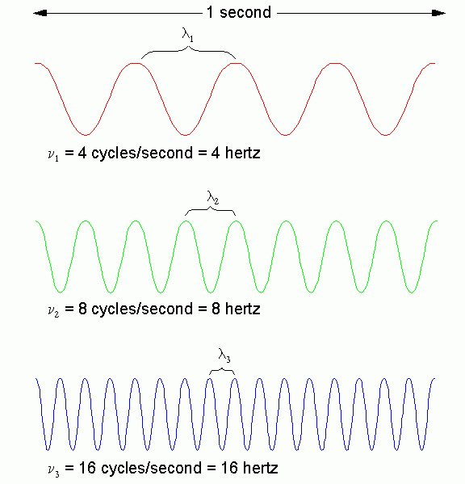
Long
Wavelength
=
Low Frequency
=
Low ENERGY
Short
Wavelength
=
High Frequency
=
High ENERGY

Slide 30
Atomic Spectra
White light is made up of all the colors of the visible spectrum.
Passing it through a prism separates it.

Slide 31
If the light is not white
By heating a gas with electricity we can get it to give off colors.
Passing this light through a prism does something different.

Slide 32
Atomic Spectrum
Each element gives off its own characteristic colors.
Can be used to identify the atom.
This is how we know what stars are made of.

Slide 33
These are called the atomic emission spectrum
Unique to each element, like fingerprints!
Very useful for identifying elements

Slide 34
How does this happen?
Let’s look at a hydrogen atom, with only one electron, and in the first energy level.

Slide 35
Changing the energy
Heat, electricity, or light can move the electron up to different energy levels. The electron is now said to be “excited”

Slide 36
Changing the energy
As the electron falls back to the ground state, it gives the energy back as light (photon)

Slide 37
Changing the energy
They may fall down in specific steps
Each step has a different energy

Slide 38
{
{
{
http://www.colorado.edu/physics/2000/quantumzone/lines2.html

Slide 39
Ultraviolet
Visible
Infrared
The further they fall, more energy is released and the higher the frequency.

