Slide 1
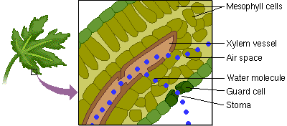
Photosynthesis

Slide 2
I. Capturing the Energy of Life
All organisms require energy
Some organisms (autotrophs) obtain energy directly from the sun and store it in organic compounds (glucose) during a process called photosynthesis
6CO₂ + 6H₂O + energy --> 6O₂ + C₆H₁₂O₆

Slide 3
II. Energy for Life Processes
Energy is the ability to do work
Work for a cell includes growth & repair, active transport across cell membranes, reproduction, synthesis of cellular products, etc.
Autotrophs or producers convert sunlight, CO₂, and H₂O into glucose (their food)
Other autotrophs use inorganic compounds instead of sunlight to make food; process known as chemosynthesis
Producers make food for themselves and heterotrophs or consumers that cannot make food for themselves
Heterotrophs include animals, fungi, & some bacteria, & protists

Slide 4
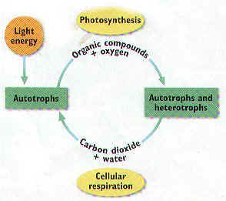

Slide 5
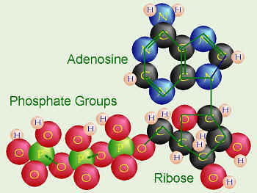
III. Biochemical Pathways
Usable energy released in cellular respiration is called adenosine triphosphate or ATP

Slide 6
IV. Light Absorption in Chloroplasts
Chloroplasts in plant & algal cells absorb light energy from the sun during the light dependent reactions
Photosynthetic cells may have thousands of chloroplasts
Grana are connected to each other & surrounded by a gel-like material called stroma
Light-capturing pigments in the grana are organized into photosystems

Slide 7
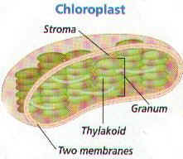

Slide 8
V. Pigments
Light travels as waves & packets called photons
Sunlight or white light is made of different wavelengths or colors carrying different amounts of energy
A prism separates white light into 7 colors (red, orange, yellow, green, blue, indigo, & violet) ROY G. BIV
When light strikes an object, it is absorbed, transmitted, or reflected
When all colors are absorbed, the object appears black
When all colors are reflected, the object appears white
If only one color is reflected (green), the object appears that color (e.g. Chlorophyll)

Slide 9
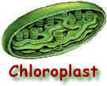
VI. Pigments in the Chloroplasts
Chlorophyll (C₅₅H₇₀MgN₄O₆) is the most common pigment in plants & algae
Chlorophyll a & chlorophyll b are the 2 most common types of chlorophyll in autotrophs
Chlorophyll absorbs only red, blue, & violet light
Chlorophyll b absorbs colors or light energy NOT absorbed by chlorophyll a

Slide 10
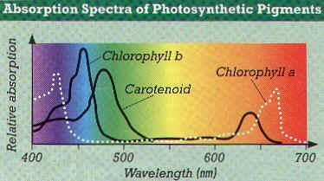

Slide 11
VII. Overview of Photosynthesis
6CO₂ + 6H₂O C₆H₁₂O₆ + 6O₂
Photosynthesis is not a simple one step reaction but a biochemical pathway involving many steps
This complex reaction can be broken down into two reaction systems --- light dependent & light independent or dark reactions

Slide 12
Light Reaction:
H₂O O₂ + ATP + NADPH₂
  Water is split, giving off oxygen.
  This system depends on sunlight for activation energy.
Electrons are passed through a series of carriers and 1 ATP (energy) and NADPH₂ is produced.

Slide 13
Dark Reaction:
ATP + NADPH + CO₂ +C₆H₁₂O₆
  Carbon dioxide is split, providing carbon to make sugars.
  The ultimate product is glucose.
  While this system depends on the products from the light reactions, it does not directly require light energy.
  Includes the Calvin Cycle.
  Takes place in the stroma.

Slide 14
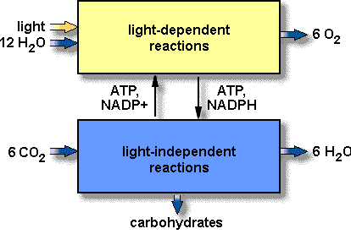

Slide 15
VIII. Calvin Cycle
The energy stored in ATP and NADPH during the Light Reactions is used in the Calvin cycle
The Calvin cycle has 3 main steps occurring within the stroma of the Chloroplast

Slide 16
STEP 1
CO2 diffuses into the stroma from surrounding cytosol
An enzyme combines a CO2 molecule with a five-carbon sugar
The six-carbon molecule produced then splits immediately into a pair of three-carbon molecules

Slide 17
STEP 2
Each molecule receives a phosphate group from a molecule of ATP
This compound then receives a H+ and e- from NADPH
These reactions produce ADP, NADP+, and phosphate which are used again in the Light Reactions.

Slide 18
STEP 3
Most PGAL is converted back to RuBP to keep the Calvin cycle going
Glucose and fructose make the disaccharide sucrose, which travels in solution to other parts of the plant (e.g., fruit, roots)

Slide 19
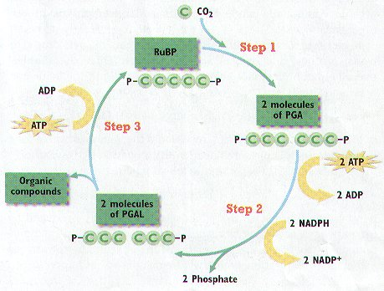

Slide 20
Each turn of the Calvin cycle fixes One CO2 molecule so it takes six turns to make one molecule of glucose

Slide 21
IX. Factors Determining the Rate of Photosynthesis
Light intensity - As light intensity increases, the rate of photosynthesis initially increases and then levels off to a plateau
Temperature - Only the dark, not the light reactions are temperature dependent because of the enzymes they use (25 ºC to 37ºC)
Length of day
Increasing the amount of carbon dioxide available improves the photosynthesis rate
Level of air pollution

Slide 22
