Slide 1
The periodic table

Slide 2
Organizing the Elements
Dmitri Mendeleev – a Russian chemist and teacher
Arranged elements in order of increasing atomic mass
Thus, the first “Periodic Table”
He left blanks for yet undiscovered elements
  When they were discovered, he had made good predictions
But, there were problems:
  Such as Co and Ni; Ar and K; Te and I

Slide 3
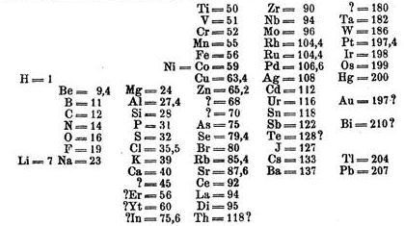
Mendeleev’s Periodic Table

Slide 4
A better arrangement
Henry Moseley (1913) –
  arranged elements according to atomic number
  still used today

Slide 5
Parts of the P.T.
Horizontal rows = periods
Vertical column = group (or family)
Columns
  Similar physical & chemical prop.
  Same valence e-
    Involved in bonding

Slide 6
Electron Configurations in Groups
Representative Elements Group A
  Display wide range of chemical properties, thus a good “representative”
  Found in s and p orbitals

Slide 7
Electron Configurations in Group B
Transition metals
  “d” sublevel
Inner Transition Metals
  “f” sublevel
  Formerly called “rare-earth” elements, but this is not true because some are very abundant

Slide 8
Groups of elements - family names
Alkali metals Group 1A
  Forms a “base” (or alkali) when reacting with water (not just dissolved!)
  Very soft (can cut with knife)
  Reacts with H₂O
  1 val. e-
Alkaline earth metals Group 2A
  Also form bases with water; do not dissolve well, hence “earth metals”
  2 val. e-
Halogens 7A
  Means “salt-forming”
  7 val. e-

Slide 9
Groups of elements - family names
Noble gases; Group 8A
  “inert gases”
    very stable
    don’t react
  Full valence e- shell
    8 val. e-
    Except He with only 2 val. e-

Slide 10
Rows
Known as a period
Are in order of increasing number of valence electrons

Slide 11
Areas of the periodic table
Three classes of elements are:
  Metals:
    electrical conductors,
    have luster (shine),
    ductile (can be made into wires),
    malleable (can be pounded into thin sheets)
    Transition Metals
    Inner transition Metals
    80% of elements are metals

Slide 12
Areas of the periodic table
Nonmetals:
generally brittle
non-lustrous,
poor conductors of heat and electricity
Some are gases
  Metalloids:
    Properties are intermediate between metals and nonmetals (have both properties)

Slide 13
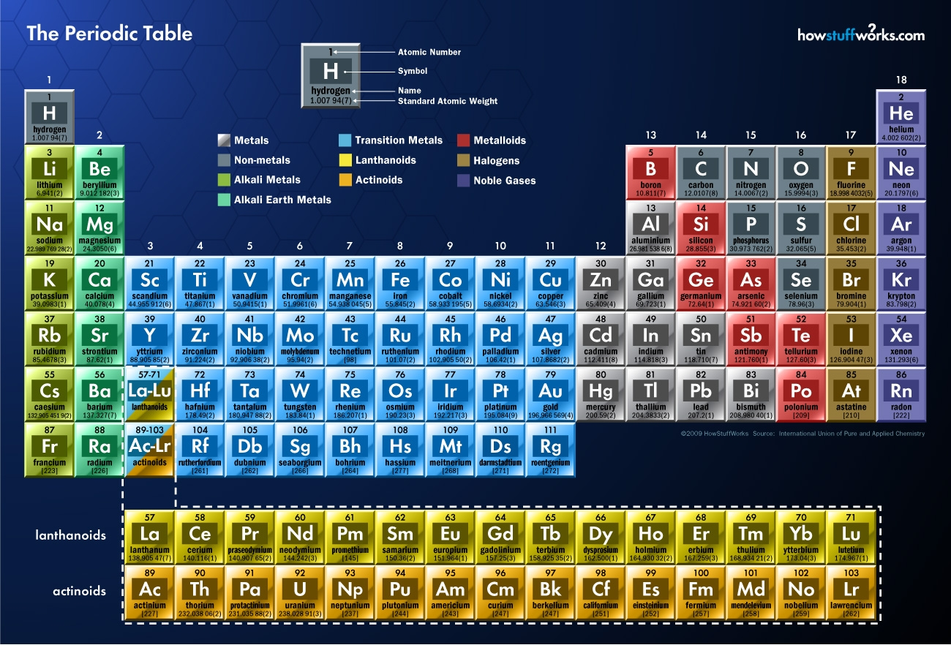
Nitrogen Family
Oxygen Family

Slide 14
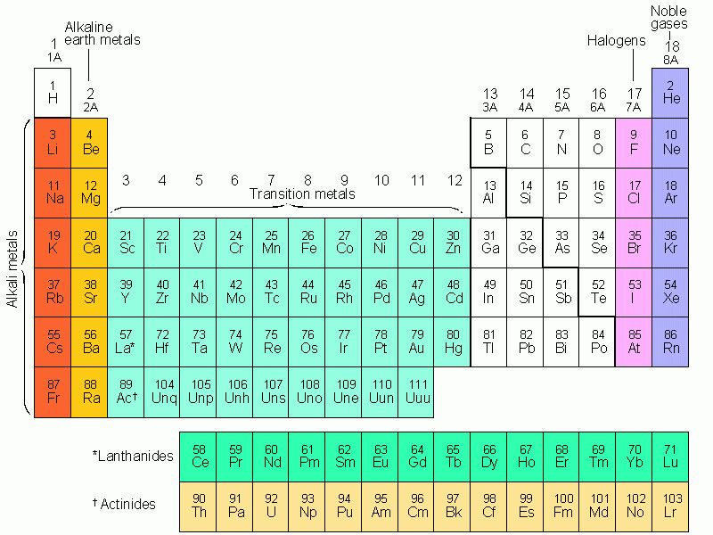

Slide 15
Transition Metals - d block
Note the change in configuration.
s¹ d⁵
s¹ d¹⁰
d¹
d²
d³
d⁵
d⁶
d⁷
d⁸
d¹⁰

Slide 16
Elements in the s - blocks
s¹
s²
He
Alkali metals all end in s¹
Alkaline earth metals all end in s²
  really should include He, but it fits better in a different spot, since He has the properties of the noble gases, and has a full outer level of electrons.

Slide 17
ALL Periodic Table Trends
Influenced by factors:
1. Energy Level
  Higher energy levels are further away from the nucleus.
2. Charge on nucleus (# protons)
  More charge pulls e- in closer (+ and – attract each other)

Slide 18
Trends in Atomic Size
Metal Reactivity
  Tendency to lose a valence electron
  As you go down a group you it is easier to lose an electron (Trend )
Nonmetallic reactivity
  Tendency to gain a valence electron
  As you go down a group you it is easier to lose an electron (Trend )

Slide 19
Atomic Size
}
Radius
Atomic Radius - this is 1/2 the distance between the 2 nuclei of a diatomic molecule
  Group Trend Period Trend

Slide 20
#1. Atomic Size - Group trends
↑ the at. # (or go down a group). . .
  each atom has another energy level
    so the atoms get bigger.
H
Li
Na
K
Rb

Slide 21
#1. Atomic Size - Period Trends
Across a period, the size gets smaller.
e- are in the same energy level.
But, there is more nuclear charge
So the outermost e- are pulled closer.
Na
Mg
Al
Si
P
S
Cl
Ar

Slide 22
Rb
K
Period 2
Na
Li
Atomic Radius (pm)
Kr
Ar
Ne
H
3
10
Atomic Number

Slide 23
Ion Review
Metals tend to LOSE e-,
  Na loses 1:
    protons (11)
    electrons (10)
    thus a + charged particle is formed = “cation”
  Written: Na⁺
  Named: “sodium ion”

Slide 24
Ion Review
Nonmetals tend to GAIN e-
  Cl gains 1 e-
    Protons (17)
    Electrons (18)
    Charge of -1
  Named a “chloride ion”
  “anions”: (-) ions

Slide 25
#2. Trends in Ionization Energy
Ionization energy - energy required to remove an e-.
  Group Trend Period Trend
First ionization energy - energy required to remove only the 1st e⁻

Slide 26
Ion Charge and Size
(+) charge
  Smaller than atomic size – Lost an e-
    Ca is larger than Ca⁺²
(-) charge
  Larger than atomic size – Gained an e-
    F is smaller than F⁻

Slide 27
Ionization Energy
Second I.E. - is the E required to remove the 2nd e⁻
  Always greater than first IE.
Third I.E. - is the E required to remove a 3rd e-
  Greater than 1st or 2nd IE.

Slide 28
Symbol First Second Third
HHeLiBeBCNO F Ne
1312 2731 520 900 800 1086 1402 1314 1681 2080
5247 7297 1757 2430 2352 2857 3391 3375 3963
11810 14840 3569 4619 4577 5301 6045 6276

Slide 29
Ionic Size
Positive ions (+) are smaller than the original atoms
Negative ions (-) are larger than the original atoms

Slide 30
Electronegativity
Electronegativity - tendency for an atom to attract e- when it’s bonded with an element.

Slide 31
Electronegativity
Down a group – e- is farther away from the nucleus
  more willing to share.
↓ column - ↓electronegativity

Slide 32
Electronegativity
Across a family – metals want to lose electrons so they have a low electronegativity
period (row) - electronegativity

